Slide 1
HEALTHCARE GRIEVANCE SYSTEM (HGS)
Resolve Complaints. Improve Care
MILESTONE - 2

Slide 2
IN MILESTONE -1
Major Problems in Current Grievance Handling
  Manual/Paper-Based Systems → hard to track, sort, report
  Slow Routing & Assignment → delays in resolution
  No Feedback Loop → no patient satisfaction tracking
  Inconsistent Communication → confusion, loss of trust
Introduction of HGS
-- Resolve Complaints. Improve Care

Slide 3
IN MILESTONE -1
Tech Stack
  Frontend: HTML, CSS, JavaScript
  Backend: Java with Spring Boot (JDK 25, Spring Boot 4.0.0)
  Database: MySQL
  Styling/UI: Tailwind CSS or pure CSS
Key User Roles
  Patient
  Staff
  Admin
Tools
  API Testing: Postman
  Version Control: Git & GitHub
  Deployment: Vercel/Netlify (Frontend), AWS

Slide 4
IN MILESTONE -1
To‑Do List & Progress
  Phase 1 (Frontend UI): Login/Register, Home, Patient/Admin/Staff Dashboards ✅ Done
  Phase 2 (Backend): DB Schema, Auth API, RBAC, Postman Testing 🔄 In Progress
Planned Diagrams
  Use Case Diagram
  Entity Relationship Diagram (ERD)
  Work Flow Diagram
Future Scope
  Mobile App for grievance submission & tracking
  Real‑Time Chat between patients & staff
  Multi‑Lingual Support for diverse users

Slide 5
MILESTONE - 2
PHASE - 2
Backend Creation
Database Schema (MySQL),
Core API endpoints (Submission, Retrieval, Update),
JWT Authentication
Connecting Backend to Frontend
To be done in milestone 3

Slide 6
To-Do List
Setup and Environment
Status | Task | Details
DONE | Project Initialization | Create the Spring Boot project via start.spring.io with required dependencies (Web, Data JPA, MySQL Driver, Security).
DONE | IDE Setup | Import the generated project into your IDE (VS Code) and ensure it compiles successfully.
DONE | Database Configuration | Configure the application.properties file with correct MySQL URL, username, and password.
DONE | Confirm DB Connection | Ensure the database is running and Spring Boot successfully connects upon startup (check console logs).

Slide 7
To-Do List
Data Models
Status | Task | Details
☐ | Grievance Entity | Create the Grievance.java Entity with fields (ID, Subject, Category, Details, Status, Reporter ID).
☐ | User Entity | Create the User.java Entity (Username, Password/Hash, Email, Role).
☐ | Role Entity | Create the Role.java Entity (Role ID, Role Name: e.g., "PATIENT", "STAFF", "ADMIN").
☐ | Grievance Repository | Create the GrievanceRepository.java extending JpaRepository.
☐ | User Repository | Create the UserRepository.java extending JpaRepository.

Slide 8
To-Do List
Core API Endpoints
Status | Task | Details
DONE | User Registration | User Creation: Create User and Role models. Implement logic to save a new user (defaulting to PATIENT role) with a BCrypt hashed password.
DONE | User Login | Authentication: Create AuthController. Implement logic to validate credentials and use JwtTokenProvider to generate and return the JWT Token.
DONE | Grievance Submission | Grievance Submission: Create Grievance model and GrievanceController. Implement logic to save the grievance and link it to the authenticated user's ID.
TO BE DONE | Data Retrieval (Authenticated & Role-Based Access) | Retrieval: Implement custom repository method (findByReporterId) and Controller logic to fetch only the cases associated with the authenticated user.

Slide 9
To-Do List
Final Validation & Testing
Status | Task | Details
DONE | Postman Testing | Successfully perform the full workflow: Register $\rightarrow$ Login (get JWT) $\rightarrow$ Submit Grievance (using JWT) $\rightarrow$ Get My Grievances.
DONE | DB Check | Verify that all submitted data (users, hashed passwords, and grievances) are correctly stored in the MySQL database tables.
TO BE DONE | Notification | Notifications about the grievances

Slide 10
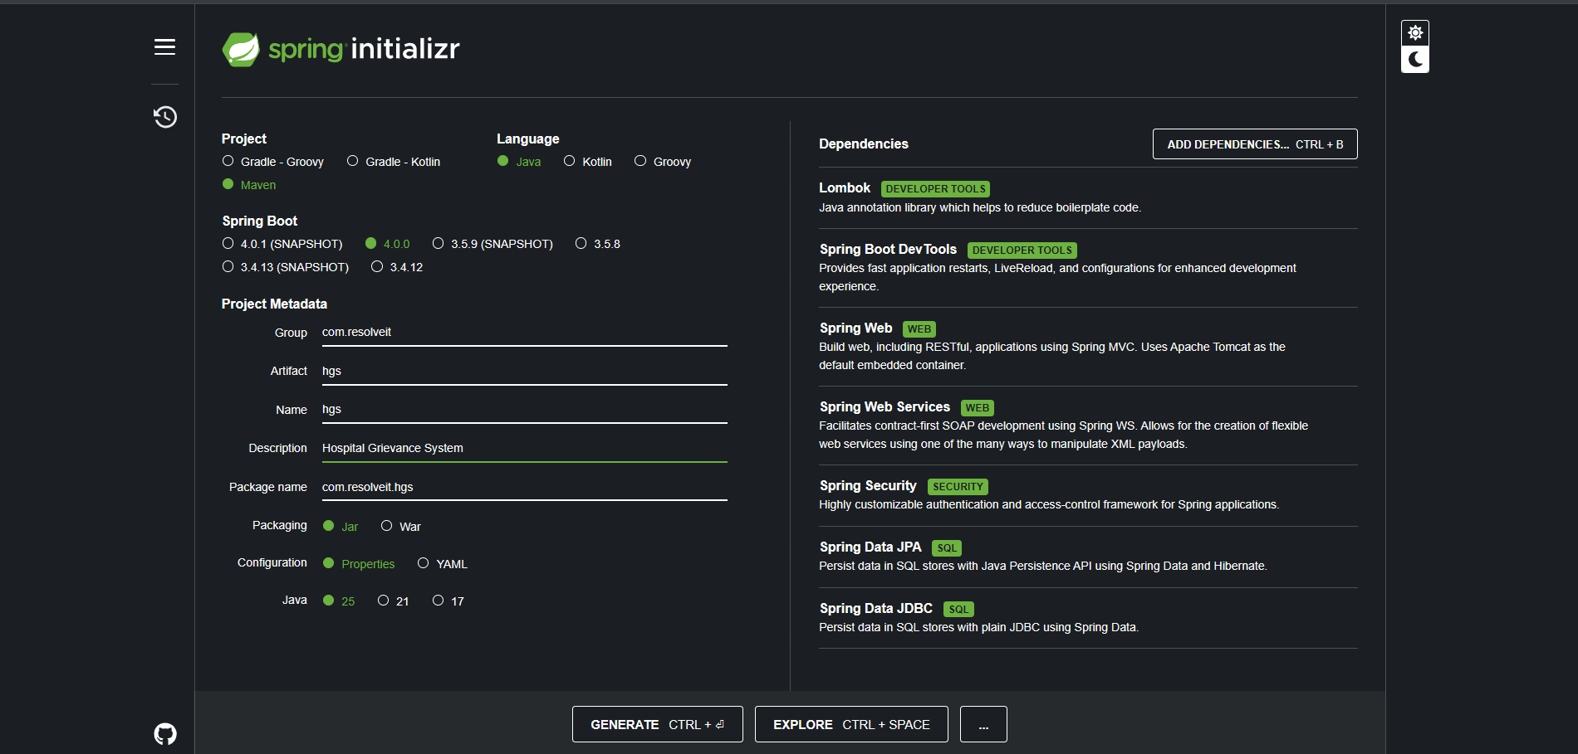
Project Initialization
Spring Initializr

Slide 11
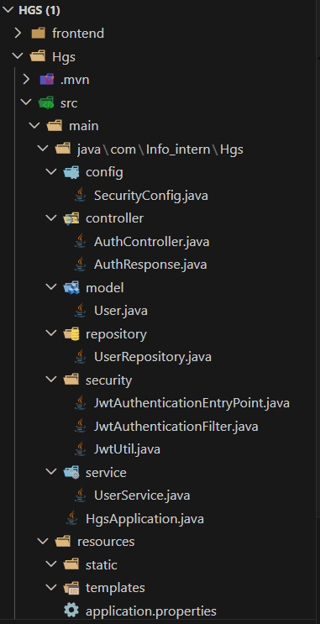
file structure

Slide 12
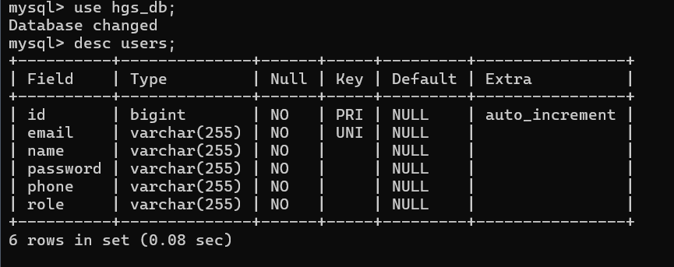
Database

Slide 13
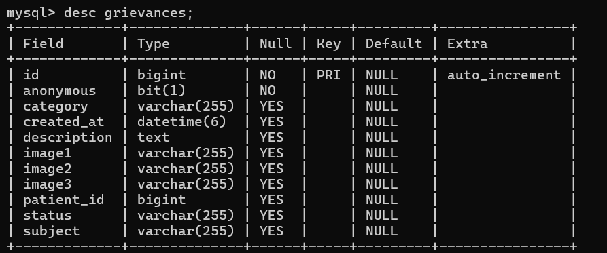
database

Slide 14
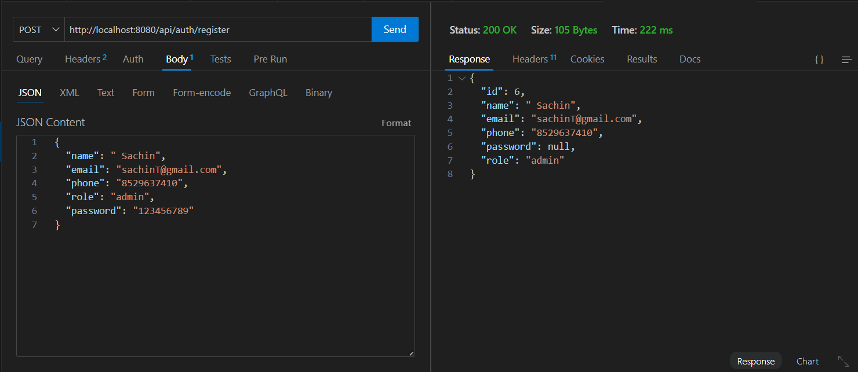
Api Testing -
Register API

Slide 15
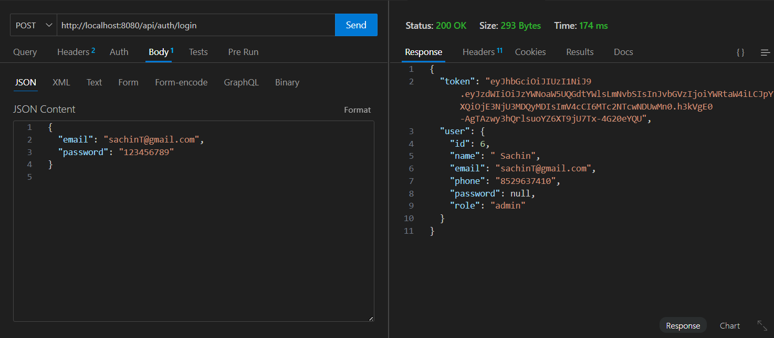
Api Testing -
Login API

